Slide 1
Network Intrusion Detection
CAPSTONE PROJECT
Presented By : Shaik Afrin
College Name : St.Ann’s College Of Engineering & Technology (Chirala)
Department : Computer Science & Engineering

Slide 2
OUTLINE
Problem Statement
Proposed System/Solution
System Development Approach
Algorithm & Deployment
Result (Output Image)
Conclusion
Future Scope
References

Slide 3
Problem Statement
Network Intrusion Detection
Create a robust network intrusion detection system (NIDS) using machine learning. The system should be capable of analyzing network traffic data to identify and classify various types of cyber-attacks (e.g., DoS, Probe, R2L, U2R) and distinguish them from normal network activity. The goal is to build a model that can effectively secure communication networks by providing an early warning of malicious activities.

Slide 4
Proposed Solution
The proposed system aims to address the challenge of predicting the Network Intrusion Detection. This involves leveraging data analytics and machine learning techniques to learn and predict Network Intrusion accurately. The solution will consist of the following components:
Data Collection:
Gather historical data on network intrusions, including protocol type, services and other relevant factors.
Data Preprocessing:
Clean and preprocess the collected data to handle missing values, outliers, and inconsistencies.
Feature engineering to extract relevant features from the data that might impact Network Intrusion prediction.
Machine Learning Algorithm:
Implement a machine learning algorithm, particularly classification algorithm, to predict Network Intrusion based on historical patterns.
Deployment:
Develop a user-friendly interface or application that provides real-time predictions for Network Intrusion.
Deploy the solution on a scalable and reliable platform, considering factors like server infrastructure, response time, and user accessibility.
Evaluation:
Assess the model's performance using appropriate metrics such as Precision, Recall, F1-score, Accuracy Score and other relevant metrics.
Fine-tune the model based on feedback and continuous monitoring of prediction accuracy.
Result

Slide 5
System Approach
We are training our model on Decision Tree classifier using ensemble learning method across various pipelines and we will choose the one with highest accuracy on test data.
Decision Tree is a tree-based machine learning algorithm which has upside down tree-like structure consisting of different decision nodes created from features with low impurity at each depth. The split is decided based on feature value.

Slide 6
Algorithm & Deployment
In the Algorithm section, describe the machine learning algorithm chosen for predicting network intrusion.
Algorithm Selection:
We are training our model on Decision Tree classifier using ensemble learning method across various pipelines and we will choose the one with highest accuracy on test data.
Decision Tree is a tree-based machine learning algorithm which has upside down tree-like structure consisting of different decision nodes created from features with low impurity at each depth. The split is decided based on feature value.
Data Input:
Input features are selected by the algorithm based on rate of impurity measured by Gini Impurity or Entropy Value, the feature with low impurity and high information gain is selected as a decision node till a leaf node is found which has zero impurity.
Training Process:
Training is done on IBM cloud ML services platform which leverages ensemble techniques and uses the best model based on cross-validation score.
Prediction Process:
Predictions are made by the model based on the features values provided by the user, the model outputs class 1 or 0 for Intrusion or not an intrusion

Slide 7
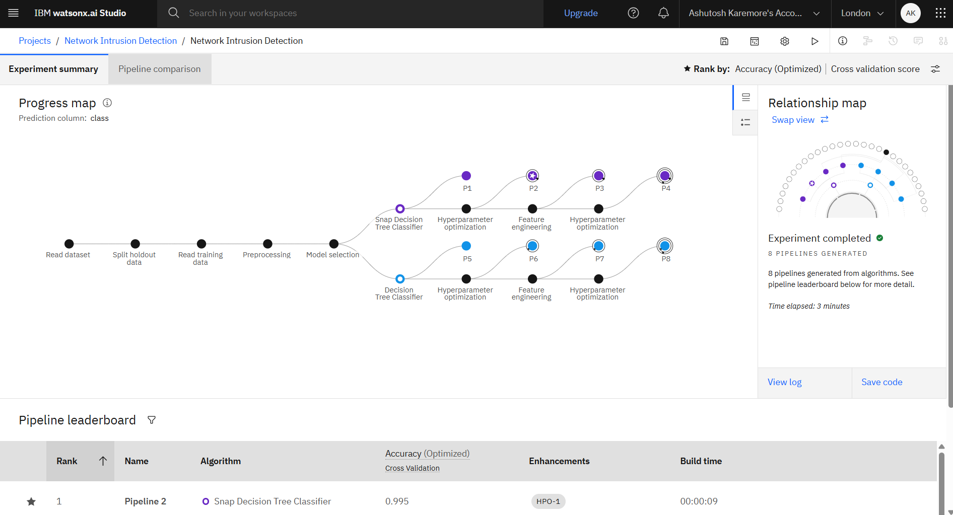
Result
Link to deployed model : https://eu-gb.ml.cloud.ibm.com/ml/v4/deployments/a1eeb2e4-9788-473d-953c-bce56dc707c1/predictions?version=2021-05-01

Slide 8
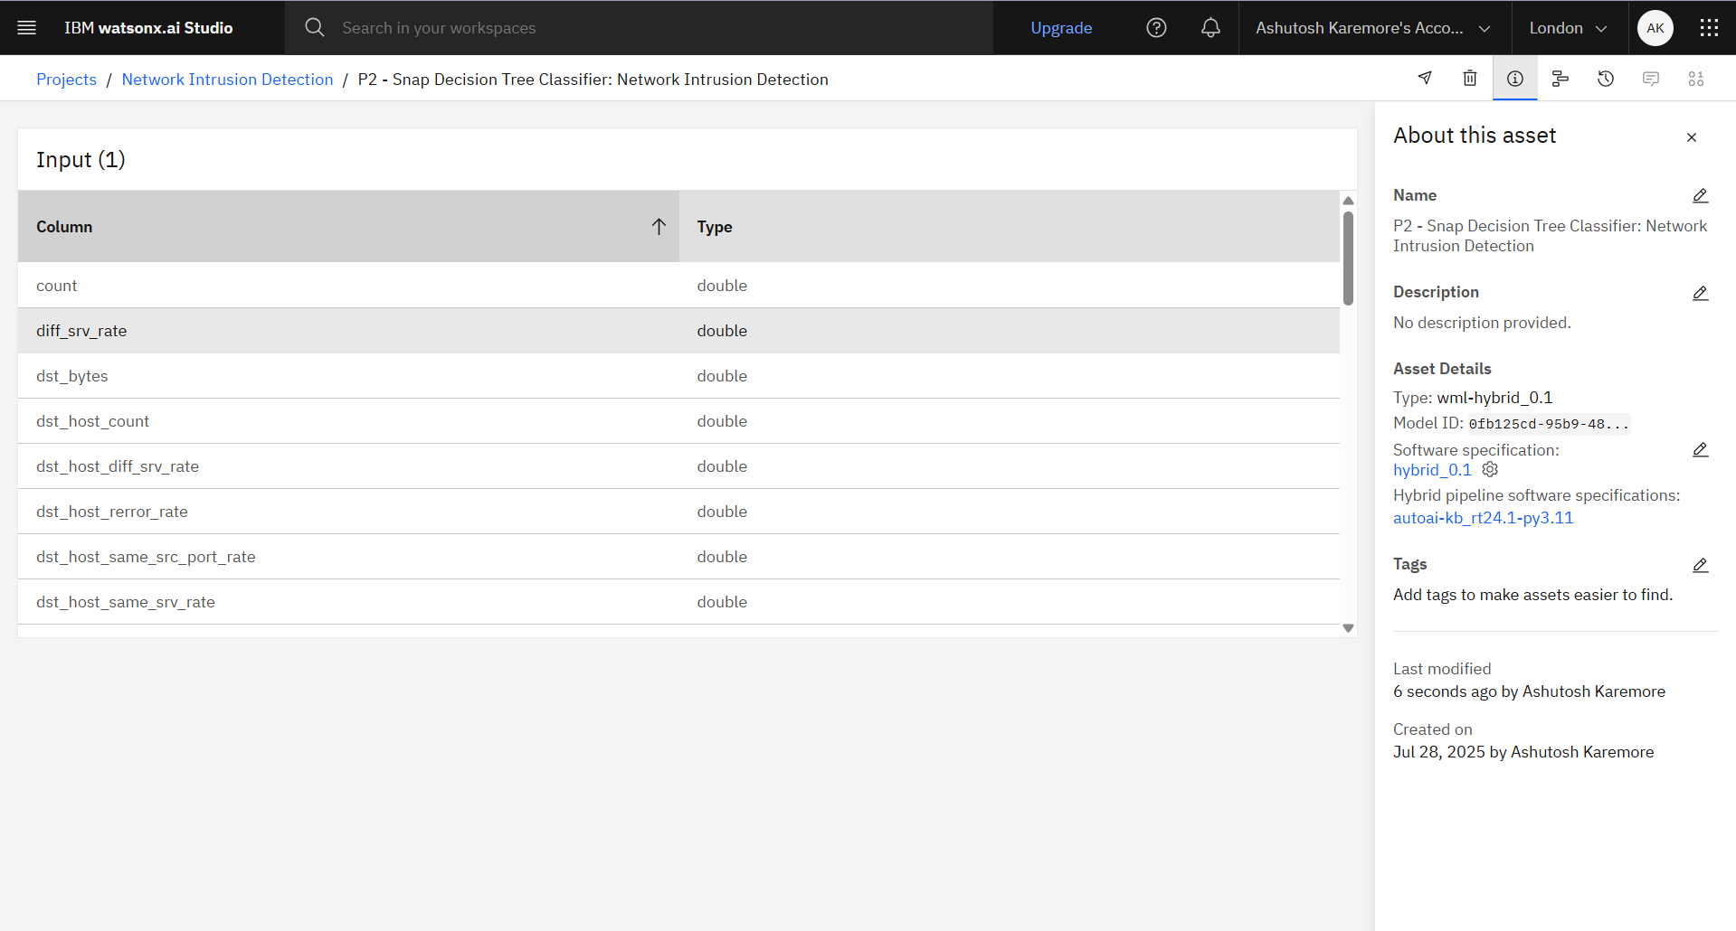
Result

Slide 9
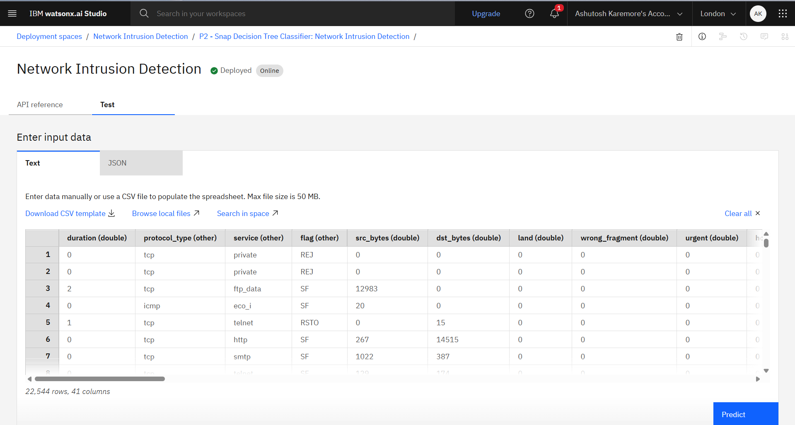
Result

Slide 10
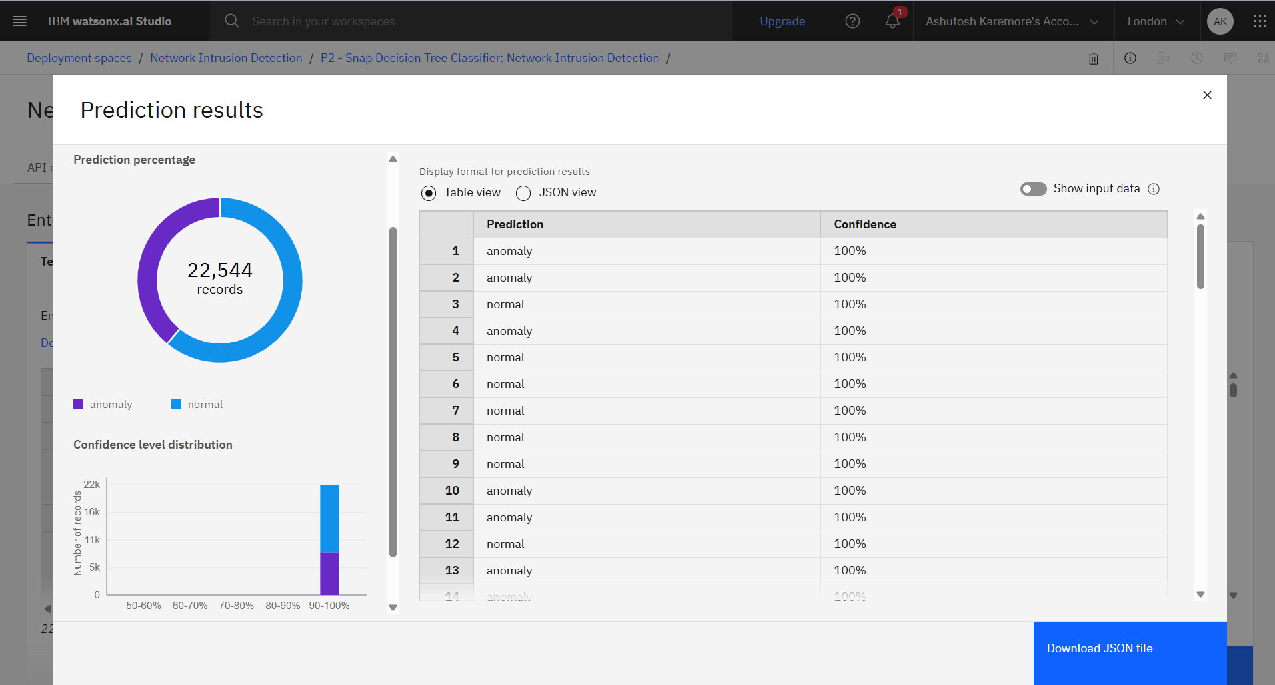
Result

Slide 11
Conclusion
We have successfully trained a machine learning algorithm and created a model with predict the network intrusion activity with an accuracy of 99.5%.
Detecting Network Intrusion is very crucial for timely rectifying any underlying issue that might affect business services, our model has learned and predicted with a high accuracy. Further with more real-time data we can learn our model to continuously adopt to the changing data.

Slide 12
Future scope
Detecting Network Intrusion is very crucial for timely rectifying any underlying issue that might affect business services, our model has learned and predicted with a high accuracy. Further with more real-time data we can learn our model to continuously adopt to the changing data.

Slide 13
References
Decision Tree Classifier Paper : https://ieeexplore.ieee.org/document/6498972/
https://www.sciencedirect.com/science/article/pii/S1877050916311127
Dataset used: https://www.kaggle.com/datasets/sampadab17/network-intrusion-detection
https://cloud.ibm.com/docs
https://www.ibm.com/docs/en/watsonx/saas?topic=solutions-autoai-machine-learning

Slide 14

IBM Certifications

Slide 15

IBM Certifications

Slide 16

IBM Certifications

Slide 17
THANK YOU

